Slide 1
Scaling of 400 external models with ESSIM

Slide 2
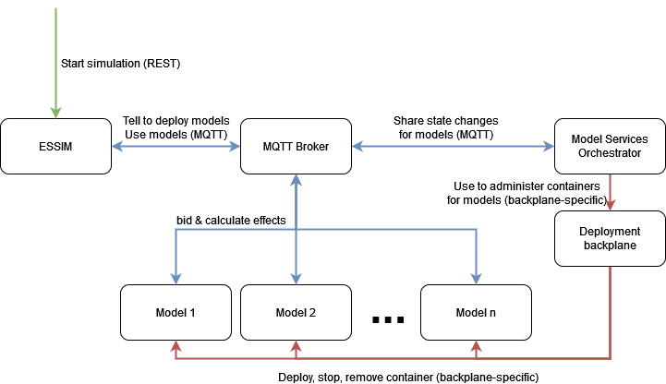
Architecture overview

Slide 3
Sequence diagram

Slide 4
MQTT broker concerns
No disk retention
Supports MQTT QoS 1
High throughput (see performance analysis later on)

Slide 5
Model Services Orchestrator (MSO) concerns
Periodic polling of status for deployed containers. ESSIM should be notified on termination (both willfully and on error states). ESSIM is simulation orchestrator so this component may decide what happens next.
Allow the integration of a datastore containing configurations for future work. This datastore will be queried before deploying the containers with the deployment backplane.
Allow ESSIM to configure containers (ESDL specific parameters) while also allowing deployment parameters. (Deployment parameter example: simulation id & ESDL node id)
Is able to deploy containers upon request of ESSIM.
Can support one or more ESSIM instances.
One ESSIM instance may be running multiple simulations simultaneously.
Uses MQTT communication protocol for communication.

Slide 6
MQTT expected performance analysis
Expectation of significant effects:
3 messages per model per heartbeat per commodity between ESSIM for bidding resolution (createBid, bid & allocation).
Expecting 2-3 heartbeats per second. Set to 3 as worstcase. May be more if ESSIM generates heartbeats faster.
Expecting 1.25 commodity per model on average.
Expecting 400 models per simulation communicating with a single ESSIM during the simulation. (one-to-many communication model)
Expecting messages of around 1 kB.
New heartbeats are not generated until older heartbeats are resolved. This will act as a natural barrier in system.
Conclusion:
MQTT setup should expect 402 hosts communicating around 4500 messages/kB per second per simulation.
ESSIM should expect 4500 messages per second per simulation.
Expecting 8760 heartbeats per simulation. A heartbeat is around one hour of simulation and a simulation simulates a year. So 24*365=8760 heartbeats.
Conclusion:
MQTT setup & ESSIM should expect 13.140.000 messages per simulation.
A simulation will take (fastest) around 49 minutes.
Risks:
MQTT setup is not able to process message load. Mitigation: Benchmark MQTT broker in advance on a relatively slow system.
ESSIM is not able to process the large amount of messages and becomes a bottleneck. Mitigation: None for now. Perhaps distribute ESSIM or accept that a simulation will take longer due to MQTT & network overhead?
ESSIM generates heartbeats faster which will increase message load. Mitigation: None as this shifts the bottleneck from ESSIM to MQTT node or models and the simulation will go as fast as it can. Expect increased response latency from ESSIM’s perspective. This is a good thing. Bottleneck analysis in this situation is necessary to improve situation and difficult to predict now.

Slide 7
MQTT benchmarking
Tried HiveMQ, aedes (MoscaJS), nanoMQ and found all solutions very slow using default configuration.
Mosquitto had a nice throughput using default configuration. Decided to investigate further.
Benchmarking setup: Fedora inside Virtualbox using 2 cores / 4 threads, SSD storage, 9 GB DDR4 SODIMM memory. MQTT broker & benchmarking nodes (GoLang) running on localhost network.
Results for 1 publisher to 1 subscriber, 1 publisher to many subscribers and many publishers to 1 subscriber experiments on next slides.

Slide 8
MQTT benchmarking Mosquitto results One-to-One
1 publisher sending 1.000.000 messages to 1 subscriber
At the subscriber side: ========= TOTAL (1) ========= Number of messages received: 1000000 Total Runtime (sec): 170.393 Average Runtime (sec): 168.129 Msg latency min (ms): 0.038 Msg latency max (ms): 19.501 Msg latency mean mean (ms): 0.580 Msg latency mean std (ms): 0.000 Average Bandwidth (msg/sec): 5947.807 Total Bandwidth (msg/sec): 5947.807 Duplicates: 0
At the publisher side: ========= TOTAL (1) ========= Total send success ratio: 1.000 (1000000/1000000) Total Runtime (sec): 168.142 Average Runtime (sec): 168.117 Msg send time min (ms): 0.022 Msg send time max (ms): 17.705 Msg send time mean mean (ms): 0.166 Msg send time mean std (ms): 0.000 Average Bandwidth (msg/sec): 5948.242 Total Bandwidth (msg/sec): 5948.242

Slide 9
MQTT benchmarking Mosquitto results One-to-many
1 publisher sending 200 messages copied to 400 subscribers.
At the subscriber side: ========= TOTAL (400) ========= Number of messages received: 80000 Total Runtime (sec): 2.884 Average Runtime (sec): 1.236 Msg latency min (ms): 2.911 Msg latency max (ms): 42.776 Msg latency mean mean (ms): 10.403 Msg latency mean std (ms): 1.447 Average Bandwidth (msg/sec): 161.885 Total Bandwidth (msg/sec): 64754.166 Duplicates: 0
At the publisher side: ========= TOTAL (1) ========= Total send success ratio: 1.000 (200/200) Total Runtime (sec): 1.260 Average Runtime (sec): 1.260 Msg send time min (ms): 2.932 Msg send time max (ms): 18.157 Msg send time mean mean (ms): 6.285 Msg send time mean std (ms): 0.000 Average Bandwidth (msg/sec): 158.755 Total Bandwidth (msg/sec): 158.755

Slide 10
MQTT benchmarking Mosquitto results Many-to-one
400 publishers each sending 200 messages to 1 subscriber
At the subscriber side: ========= TOTAL (1) ========= Number of messages received: 80000 Total Runtime (sec): 9.433 Average Runtime (sec): 2.806 Msg latency min (ms): 0.067 Msg latency max (ms): 249.420 Msg latency mean mean (ms): 64.968 Msg latency mean std (ms): 0.000 Average Bandwidth (msg/sec): 28506.450 Total Bandwidth (msg/sec): 28506.450 Duplicates: 0
At the publisher side: ========= TOTAL (400) ========= Total send success ratio: 1.000 (80000/80000) Total Runtime (sec): 2.784 Average Runtime (sec): 2.669 Msg send time min (ms): 0.02 Msg send time max (ms): 139.962 Msg send time mean mean (ms): 11.635 Msg send time mean std (ms): 0.534 Average Bandwidth (msg/sec): 75.074 Total Bandwidth (msg/sec): 30029.409

Slide 11
Deployment backplane concerns
Can manage a group of containers that are deployed for a simulation.
Can use a Docker registry from which to pull image.

Slide 12
Deployment backplane requirements
Need: Has API through which containers may status polled.
Failed status based on non-zero exit code.
Successful status based on zero exit code.
Running if not terminated.
Need: Has API which can be used as a general health check for the backplane.
Need: Can deploy containers based on image name and url+port to registry so both TNO and public registries may be used.
Need: Can manage multiple worker nodes.
Need: Is able to stop and remove containers for both running and non-running.
Need: Containers may be started with env var parameters.
Want: Light weight in terms of CPU, memory & disk overhead.
Want: Accessible
Want: Do operations on groups of containers based on simulation id such as stopping, removing and polling of the status so these actions only take a single API call.

Slide 13
Deployment backplane options
Public cloud e.g. AWS Fargate or Azure Container Instances
Hashicorp Nomad
Docker swarm
Anna advises against this option. Illsuited for production.
Kubernetes
Status-quo for distributed container deployments.
Has REST API through which containers may be deployed & status polled.
TBD: Has a general healthcheck?
Homebrew
Due to available options and investment needed, does not appear a wise choice.

Slide 14
Healthcheck system why?
Models should not exist in perpetuum if orchestrator is missing. Should terminate itself.
System should describe what the issue is and where it is located on the nodes that are available/healthy.
MSO should log an error to show an unexpected state for debugging purposes.
ESSIM should log an error to show an unexpected state for debugging purposes.
ESSIM should not accept simulations using external models if the architecture cannot deploy models successfully.

Slide 15
Healthcheck system how? 1/2
Healthchecks using ping/pong system where unhealthy status is only set when dependant systems are missing/unhealthy.
Pingpong interval: every 2 seconds.
ESSIM sends ping to MSO with health status.
Check: ESSIM is unhealthy if MSO did not receive ping within 1.5x the pingpong interval or unhealthy reply.
Reaction: MSO logs error that ESSIM is unhealthy.
MSO replies with pong to ESSIM with health status.
If MSO is healthy, set health status for ESSIM to healthy.
Check: MSO is unhealthy if ESSIM did not receive pong within 1.5x the pingpong interval or unhealthy reply.
Reaction: ESSIM logs error and should not accept simulations that use external models. Also set health status of ESSIM to unhealthy.

Slide 16
Healthcheck system how? 2/2
MSO sends ping to Model with health status.
Check: MSO is unhealthy if Model did not receive ping within 1.5x the pingpong interval or unhealthy reply.
Reaction: Models logs error that MSO is unhealthy and terminates.
(See next slide for pong)
MSO uses API to deployment backplane to check status on backplane.
If successfully response, MSO should set healthy status.
Check: Expect a reply and check if backplane is healthy.
Reaction: If deployment backplane is not reachable or unhealthy, MSO will set unhealthy status.

Slide 17
Simulation healthcheck system
Uses ping/pong healthcheck system.
Independent of component health, integrity of simulations must be maintained.
ESSIM simulations should know if the simulation is tainted due to unhealthy behaviors and who the cause is.
Model replies with pong to MSO with health status.
Check: Model is unhealthy if MSO did not receive pong within 1.5x the pingpong interval or unhealthy reply.
Reaction: MSO logs error that model is unhealthy and sends UnhealthyModel to ESSIM. ESSIM should log unhealthy state as an error and terminate the simulation as unsuccessful.
MSO uses API to deployment backplane to check status on models.
Check: Expect a reply and each model should be running, failed or successful.
Reaction: MSO sends ModelHasTerminatedSuccessfully or ModelhasTerminatedFailed to ESSIM if model has terminated with exitcode 0 or non-0 respectively according to deployment backplane. If there is an issue with reaching the backplane, set unhealthy status for MSO.

Slide 18
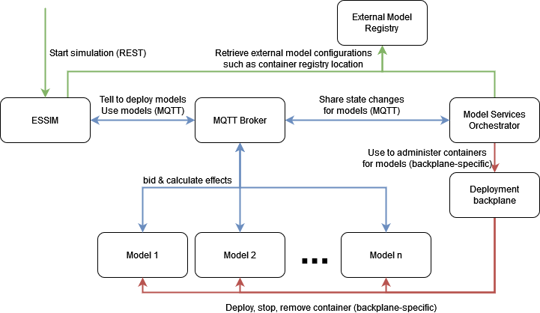
Architecture overview future work
Add an external model registry so configurations aren’t repeated across simulations.

Slide 19
Deployment backplane tools
Kubernetes (K3S)
K3S distro suits small clusters quite well / lightweight.
Integrated load balancer.
Server/master & client/node may be used on same machine but impacts performance.
Public cloud Kubernetes-managed clusters are available e.g. Azure Instances.
Kubernetes standard is opensource community managed.
Has a software-defined networking model, built-in monitoring.
K3S distro already has 18K stars on Github, let alone the 82K stars of the main K8S project.
Nomad Hashicorp
Single binary agent -> Easy to set up.
Can deploy non-container applications as well and Windows support.
Integrated toolsuit with terraform (infra as code), vault (secrets management) & others.
Uses separately configured load balancer.
Uses HCL language (alternative to YAML/JSON)
Must be self-hosted / on-premise.
Simpler & easier to deploy & maintain. For example: https://thenewstack.io/conductor-why-we-migrated-from-kubernetes-to-nomad/
Relatively small community / popularity (only 10K stars Github)
No overlay networking model (see Consol) & monitoring may be deployed with Consol or Promotheus.
Needs Consol (another binary) for service discovery, configuration key/value store & transparent, mutual TLS between nodes
Not standardized, managed by Hashicorp company
Lightweight as most features need to be added and K8S have them ready to go. Faster than K8S and can handle much higher scale (2 million containers challenge).
Nice collection of blogs: https://redhatspain.com/kubernetes-alternatives/
Conclusion: K3S will work while Nomad will probably work. Nomad worth an experiment to gain experience on the tool although time does not appear to permit? So K3S? Yes we chose K3S.

Slide 20
Deployment backplane options
K3S
Azure
AWS
On-Premise GEIS ← Public cloud would need money which we do not have, GEIS we already have (free to us)
Nomad
On-Premise GEIS

Slide 21
MQTT messages
DeployModels
ReadyForProcessing
ModelsReady
SimulationDone
UnhealthyModel
ModelhasTerminatedFailed
ModelHasTerminatedSuccessfully
AllModelsHaveTerminated
PingHealthESSIMToMSO
PongHealthMSOToEssim
PingHealthMSOToModel
PongHealthModelToMSO

Slide 22
MQTT message specifics 1/5
/lifecycle/essim/mso/<simulationID>/DeployModels
Publisher: ESSIM
Subscriber: MSO
Fields:
essimID (string, uuid)
modelConfigurations (repeated ModelConfiguration)
modelID (string, uuid)
containerUrl (string): Including hostname, port & container name
environmentVariables (repeated EnvironmentVariable): Contains at least SIMULATION_ID, MODEL_ID (node id), MQTT_HOST & MQTT_PORT
name: (string)
value: (string)

Slide 23
MQTT message specifics 2/5
/lifecycle/model/mso/<simulationID>/<modelID>/ReadyForProcessing
Publisher: Model 1..n
Subscriber: MSO
Fields: None
/lifecycle/mso/essim/<simulationID>/ModelsReady
Publisher: MSO
Subscriber: ESSIM
Fields: None
/lifecycle/essim/mso/<simulationID>/SimulationDone
Publisher: ESSIM
Subscriber: MSO
Fields: None

Slide 24
MQTT message specifics 3/5
/lifecycle/mso/essim/<simulationID>/<modelID>/UnhealthyModel
Publisher: MSO
Subscriber: ESSIM
Fields:
status (enum NOPROGRESS): If number of bids and allocations have not changed between 2 pingpong intervals.
/lifecycle/mso/essim/<simulationID>/<modelID>/ModelHasTerminated
Publisher: MSO
Subscriber: ESSIM
Fields:
Status (enum SUCCESSFUL | FAILED)
exitCode (int): The exit code of the container / model process.
/lifecycle/mso/essim/<simulationID>/AllModelsHaveTerminated
Publisher: MSO
Subscriber: ESSIM
Fields: None

Slide 25
MQTT message specifics 4/5
/healthcheck/essim/mso/<essimID>/PingHealthESSIMToMSO
Publisher: ESSIM
Subscriber: MSO
Fields:
healthy (enum HEALTHY | UNHEALTHY): If ESSIM considers itself healthy.
reasons (repeated string): Why is ESSIM unhealthy?
activeSimulations (repeated string): List of simulation ids for which the simulations are active considered by ESSIM.
/healthcheck/mso/essim/<essimID>/PongHealthMSOToEssim
Publisher: MSO
Subscriber: ESSIM
Fields:
healthy (enum HEALTHY | UNHEALTHY): If MSO considers itself healthy.
reasons (repeated string): Why is MSO unhealthy?

Slide 26
MQTT message specifics 5/5
/healthcheck/mso/model/<modelID>/PingHealthMSOToModel
Publisher: MSO
Subscriber: Model 1..n
Fields:
healthy (enum HEALTHY | UNHEALTHY): If MSO considers itself healthy.
reasons (repeated string): Why is MSO unhealthy?
/healthcheck/model/mso/<modelID>/PongHealthModelToMSO:
Publisher: Model 1..n
Subscriber: MSO
Fields:
numberOfBids (int): How many bids have been generated by model.
numberOfAllocations (int): How many allocations have been allocated by model.
healthy (enum HEALTHY | UNHEALTHY): If the model considers itself healthy.
reasons (repeated string): Why is model unhealthy?

Slide 27
Protocol on top of MQTT
Protobuf 3.0
Requires message schemas written in Protobuf DSL.
Allows for optional fields.
Allows for backwards & forward compatibility.
Supports many languages.
Considerations:
Not self-descriptive. We need to know the message type before parsing. -> one message type per topic.
Chosen over:
Avro
No optional fields.
JSON
No schema-definition approach.
Slow and verbose due to ASCII encoding compared to binary encoding of Protobuf.

